Slide 1
CureMD's Most Commonly Used Reports​
Steven Bradley

Slide 2
RealTime Vs Canned/ Data Mining Reports
RealTime
Canned/ Data Mined
My Notes
Charge Custom View
Financial Overview
Lab Advanced View
Today’s Patients
Appointment Status Tab
Over 140 Report
Largely Sourced from Charges
Various Categories of AR, Scheduling…

Slide 3
My Notes/ Provider Note

Slide 4
Charge Custom Views

Slide 5
Financial Overview

Slide 6
Lab Advanced View

Slide 7
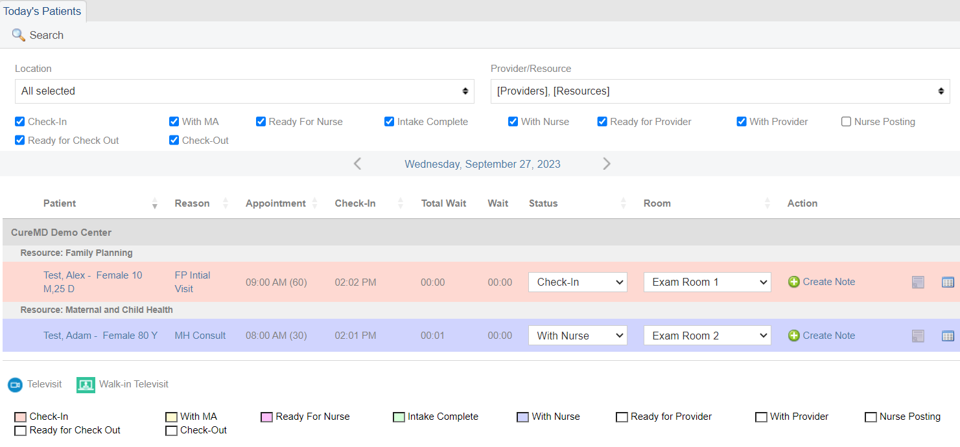
Todays Patients

Slide 8
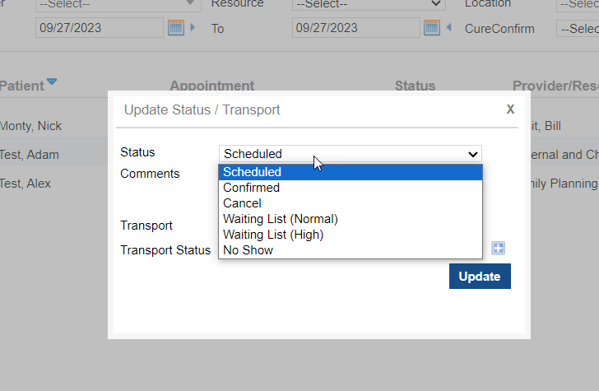
Appointment Status Tab

Slide 9
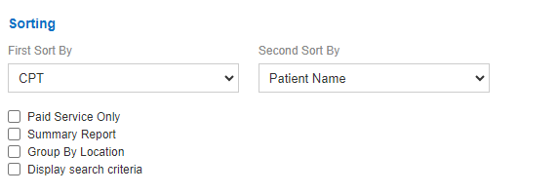
Canned Reports FYI’s
Sources of Data
Sorting Options/ Details Vs Summary Selection
Favoriting Reports

Slide 10
Demographic/ Appointment Reports
Patient Search Report
Powerful Report for Identifying Patients
Mass Texting or Email
Patient -> Demographics
Searchable by Registration/ Appointment Date
Scheduling -> Enterprise Report
Summary Vs Reason Summary Views

Slide 11
Clinical/ Service Reports
Health Department -> Service Details
Breakdown of services/ CPT codes/ Diagnosis Codes Used
Public Health Surveillance -> Index Cases
Searchable by Diagnosis to see all Cases and Associated Contacts
EHR -> Medications
Allows for Searching of a specific medication to see associated patients

Slide 12
Accounts Receivable Reports
Miscellaneous -> Billing Summary
CPT Level Reporting on Outstanding or Paid Visits
Claims -> Occupational Medicine
Creation of Invoice to Bill Businesses
Collection Ratio -> Collection Ratio Monthly Report
Displays charged amounts and generates % of current payment
Health Department -> First Pass Pay Rate
Displays by Payer how successful submissions are by attempt to bill
Health Department -> Payment Breakdown
Displays Payments by Program/ Service/ Calendar

Slide 13
Questions

